Slide 1
Starting School
Insert pic of child or specific school etc
A story for XXX

Slide 2
XXX has finished kinder and it is time for XXX to start school soon! XXX will be going to school name.
Insert pic of child and school

Slide 3
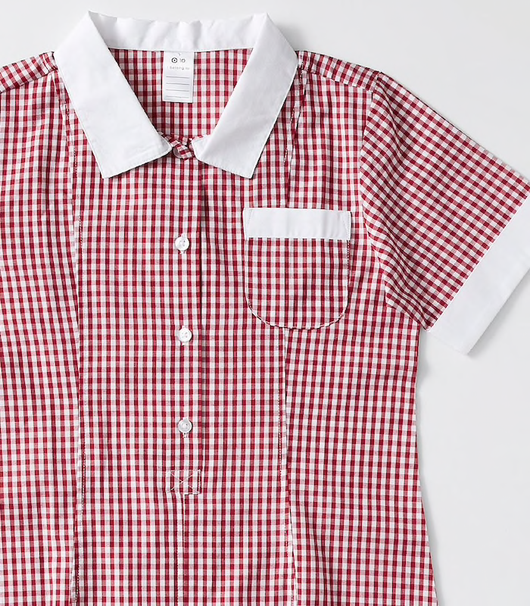
In the morning, XXX will get ready for school. He/She will get dressed in their school uniform.
Insert pic of child in school uniform

Slide 4
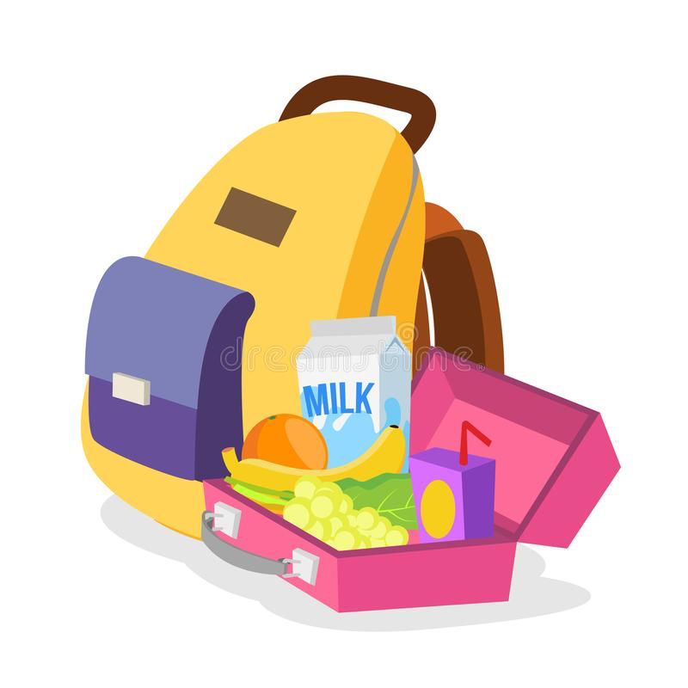
XXX will have breakfast and pack her/his bag. She/he will need to pack their lunchbox, hat and drink bottle. This is where I put my bag.
Insert pic of their bag/lunchbox and bag hook / locker etc

Slide 5
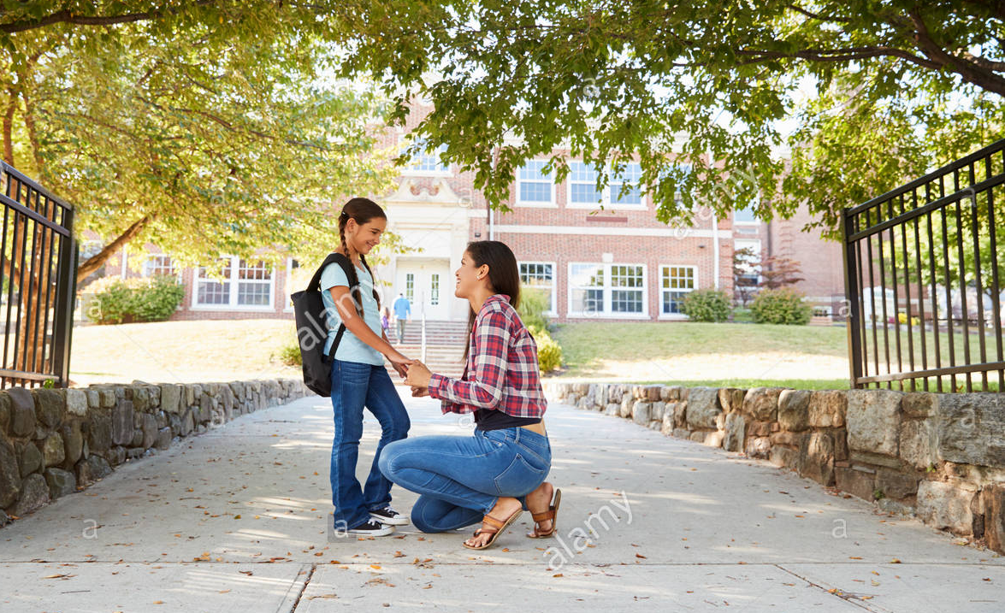
Mum or Dad will drive/walk me to school. They will drop me at the gate/classroom. They will hug goodbye.
Insert pic of where they will be dropped

Slide 6
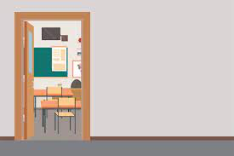
I will walk to my classroom. (? Name/distinguishing feature eg. colour). My classroom will be…
Insert pic of classroom/door

Slide 7
XXX will see their teacher Mrs/Mr X. Mrs/Mr X cares about me and will be able to help me. I can ask her/him anything.
Insert pic of teacher

Slide 8
These are some of the other adults who are there to help me at school
Insert picture of principal, vice principal, office person, specialist teachers…

Slide 9
These are the toilets…

Slide 10
These are some of the other places I will go when I go to school
Insert picture library, art room, garden, science room, drinking taps etc.

Slide 11
In XXX’s class, there will be kids that he / she might know from kinder, including XX and XX. There will also be some new friends to make!
Insert picture of child playing with friends

Slide 12
XXX will learn at school. He/she will read, write, play games.
Insert pic of child and school or child working

Slide 13
XXX will get to play outside at recess and lunchtime for a play.
Insert pic of child and school playground

Slide 14
After a big day of learning and fun, the bell will ring and it will be time for XXX to be picked up. Mum or Dad will be waiting (where) to say hello.
Insert picture of pick up point

Slide 15
Starting school is a big change. You might have lots of different feelings about starting Prep. You might feel: worried, excited, happy, scared or unsure. It is normal to feel lots of different things. Tell your mum, dad or carers about how you are feeling.

Slide 16
My mum, dad, carers and teachers are there to help me settle into school and get used to it.

Slide 17
What questions do you have about school?
What are you excited about?
What are you worried about?

