Slide 1
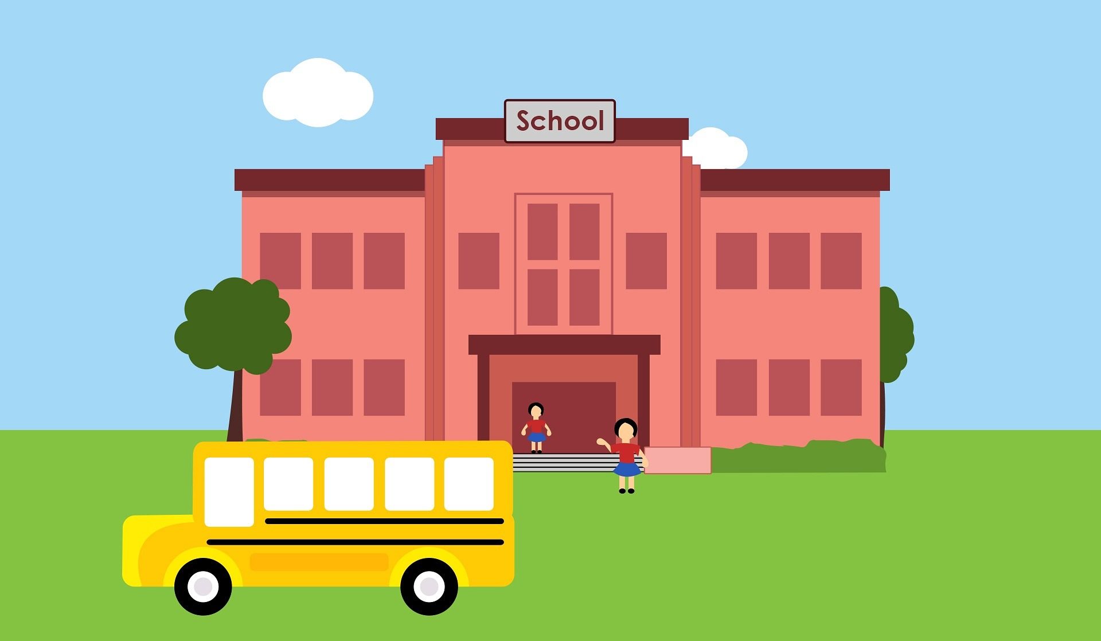
XXX is Starting School
Insert pic of child or specific school etc

Slide 2
I have finished kinder and it is time for me to start school soon! I will be going to school name.
Insert pic of child and school

Slide 3
In the morning, I will get ready for school. I will get dressed in my school uniform.
Insert pic of child in school uniform

Slide 4
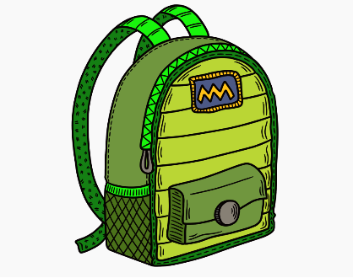
I will have breakfast and pack my school bag. I will pack my lunchbox, hat and drink bottle each day.
This is where I put my bag.
Insert pic of their bag/lunchbox and bag hook / locker etc

Slide 5

Mum / Dad / Other will help me pack my lunch every day. There will be snacks for morning tea and lunchtime. Some of the snacks I can pack are:
Insert pic of preferred snacks

Slide 6
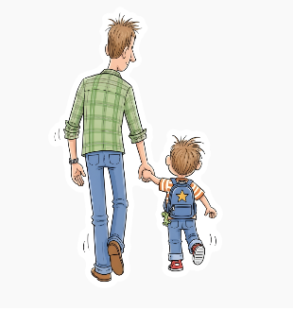
Mum /Dad / other will drive/walk me to school. They will drop me at the gate/classroom. They will hug goodbye. This is just like at kinder.
Insert pic of where they will be dropped

Slide 7
I will walk to my classroom. (? Name/distinguishing feature eg. colour). My classroom will be…
Insert pic of classroom/door

Slide 8
My teacher is Mrs/Mr X.
Mrs/Mr X is there to help me.
I can ask her/him anything.
Insert pic of teacher / child with teacher

Slide 9
These are some of the other adults who are there to help me at school
Insert picture of principal, vice principal, office person, specialist teachers…

Slide 10
In my class, there will be kids that I might know from kinder, including XX and XX. There will also be some new friends to make!
Insert picture of child playing with friends

Slide 11
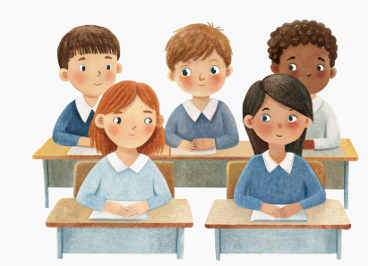

I will learn new things at school. Some of the activities we will do are: listening to stories, drawing, learning to read, write and do maths and play games. I don’t have to know how to do things before I start school.
Insert pic of child at table drawing / writing

Slide 12
We will also have specialist classes, like art and PE. We walk to a different classroom and are with a different teacher. These are the specialist classrooms and teachers:
Insert picture of specialist classrooms and teachers.

Slide 13
These are some of the other places I will go when I go to school
Insert picture library, garden, drinking taps etc.

Slide 14
I will get to play outside at recess and lunchtime for a play.
Insert pic of child and school playground

Slide 15
After a big day of learning and fun, the bell will ring and it will be time for me to be picked up. Mum or Dad or other will be waiting (where) to say hello.
Insert picture of pick up point

Slide 16
Starting school is a big change. I might have lots of different feelings about starting Prep. I might feel: worried, excited, happy, scared or unsure. It is normal to feel lots of different things. I can talk to my mum, dad or carers about how I am feeling

Slide 17
My mum, dad, carers and teachers are there to help me settle into school and get used to it.

Slide 18
What questions do you have about school?
What are you excited about?
What are you worried about?
What will help you get ready? E.g. visiting playground, playdates with friends, meeting teacher

